Slide 1
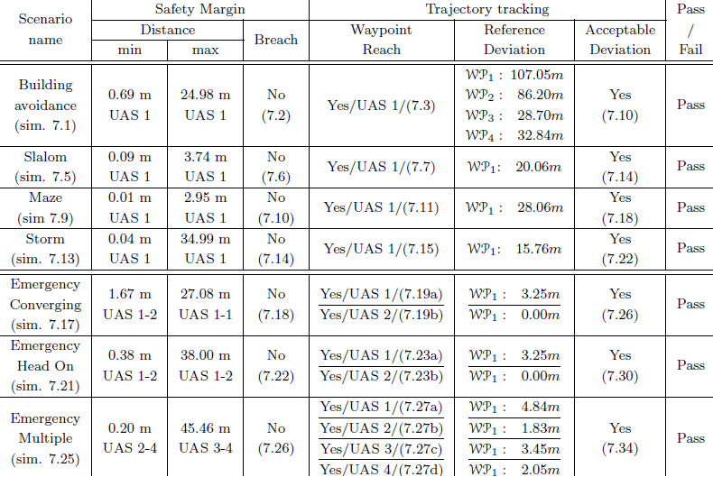
Simulations results – non-cooperative
Notes:
Speech:
For all test cases we have tracked:
“Safety margin breach” which is primary performance criterion,
All simulations have passed
Note:
There are secondary criterions,
1. Path tracking performance: - deviations from expected trajectory
2. Computation load performance – maneuver feasibility by computational point of the view
Some of simulations has not been presented
Your Notes:

Slide 2
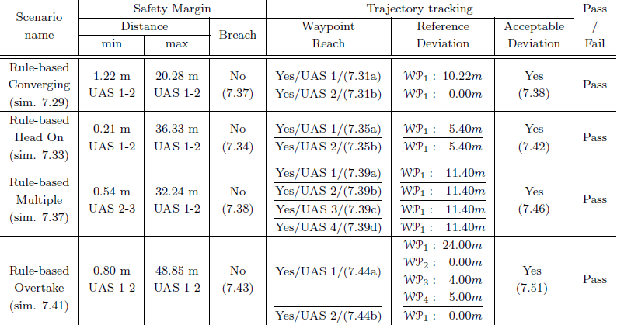
Simulations results – cooperative
Notes:
Speech:
The same goes for the cooperative test cases,
All simulations have passed,
Note:
You have seen all simulations from this test set during presentation
These test cases can be used for your approach evaluation
Your Notes:

Slide 3
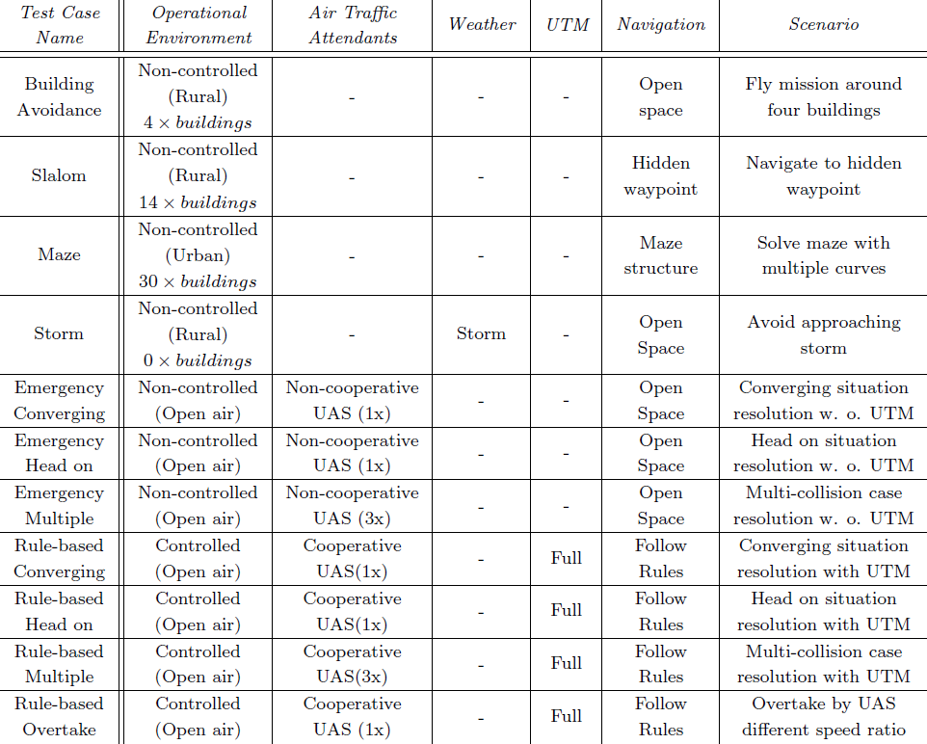
Test plan (7.1)
Notes:
Speech:
We have developed own testing framework enabling us to test:
1. Static obstacle collisions.
2. Intruder collision,
3. Weather avoidance,
4. Combination of any previous,
We have prepared and executed 13 scenarios,
Your Notes:

